Slide 1




Digital Egyptian Pioneers
CUSTOMER SEGMENTATION
FOR ONLINE RETAIL
Presented by:
Mahmoud Abdelraouf Ismael
Omar Mohamed Saad

Slide 2



CONTENT
Introduction
Objective
Dataset Overview
Data Description
Data Preprocessing
EXPLORATORY DATA ANALYSIS
Customer Segmentation
Clusters Visualization
Segmentation Insights
Conclusion
The End

Slide 3

INTRODUCTION
In today's competitive business, it is vital to understand the long-term value of a customer. This helps businesses in strategizing their marketing efforts, resource allocation and product development.

Slide 4
INTRODUCTION
Objective
The main objective is to segment customers based on their purchasing behavior to uncover hidden patterns and deliver targeted marketing strategies. This segmentation helps in understanding different customer personas, such as high spenders or infrequent buyers.

Slide 5
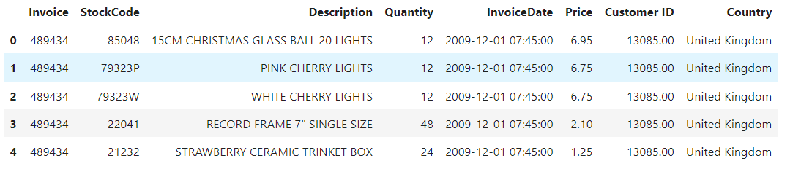

DATASET OVERVIEW
This dataset comprises transaction-level data, including product descriptions, quantities, prices, and timestamps. The focus is on identifying purchasing behavior of individual customers
This Online Retail II data set contains all the transactions occurring for a UK-based and registered, non-store online retail between 01/12/2009 and 09/12/2010.The company mainly sells unique all-occasion gift-ware. Many customers of the company are wholesalers.

Slide 6
DATA DESCRIPTION
Invoice: Invoice number. Nominal. A 6-digit integral number uniquely assigned to each transaction. If this code starts with the letter 'c', it indicates a cancellation.
StockCode: Product (item) code. Nominal. A 5-digit integral number uniquely assigned to each distinct product.
Description: Product (item) name. Nominal.
Quantity: The quantities of each product (item) per transaction. Numeric.
InvoiceDate: Invice date and time. Numeric. The day and time when a transaction was generated.
Price: Unit price. Numeric. Product price per unit in sterling (Â£).
Customer ID: Customer number. Nominal. A 5-digit integral number uniquely assigned to each customer.
Country: Country name. Nominal. The name of the country where a customer resides.

Slide 7

DATA
PREPROCESSING

Slide 8
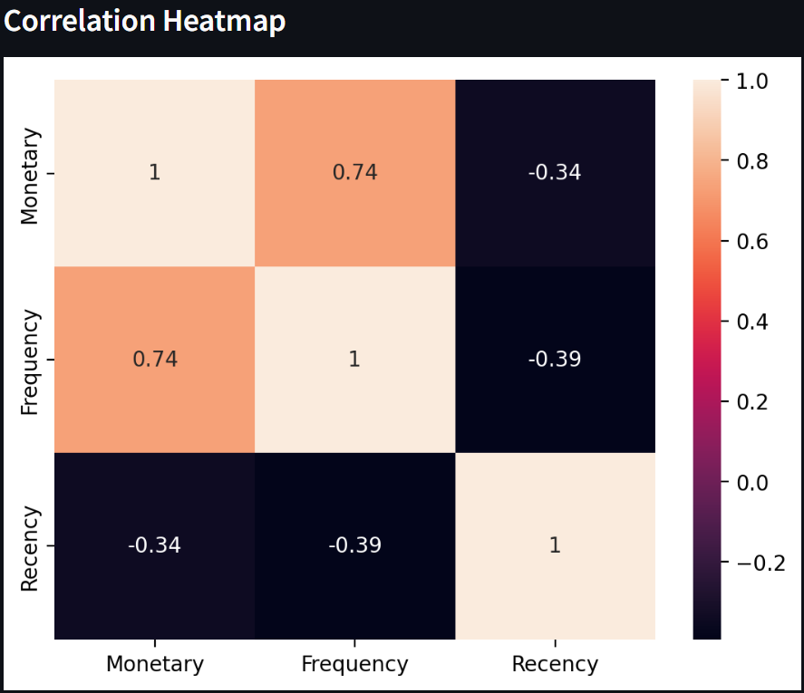
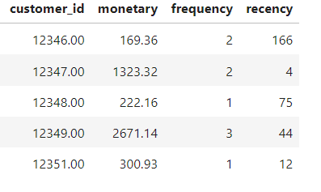
Data Cleaning
removing missing values (rows without a customer ID).
Removed duplicates and filtered out invalid transactions (negative quantities).
Created new features:
Monetary (total purchase amount per customer).
Frequency (number of transactions per customer).
Recency (days since the customer’s last purchase).
which were engineered from the raw data.
These RFM features are crucial for segmentation.

Slide 9
EDA
EXPLORATORY DATA ANALYSIS

Slide 10
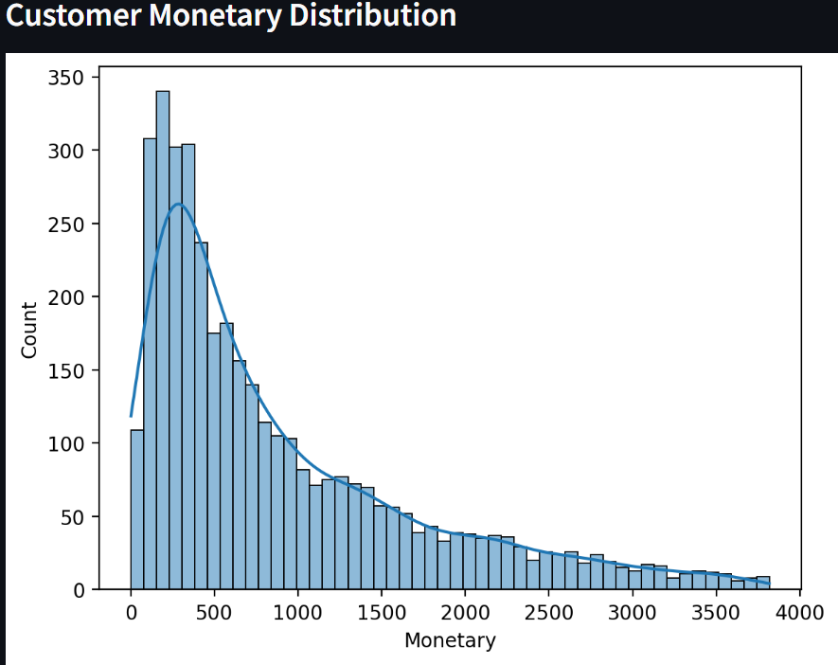

Slide 11
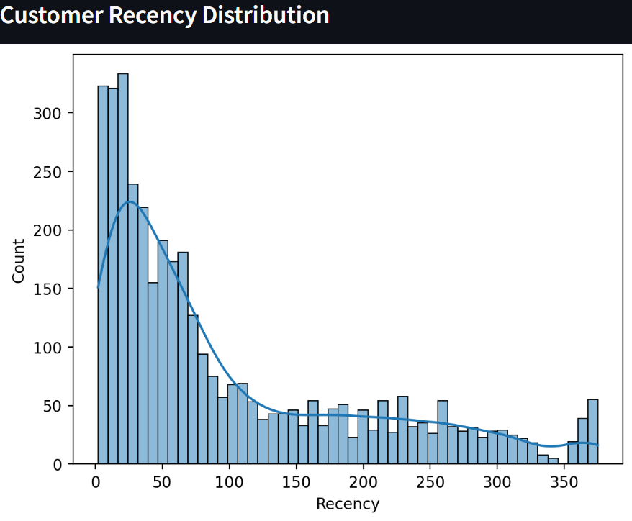

Slide 12
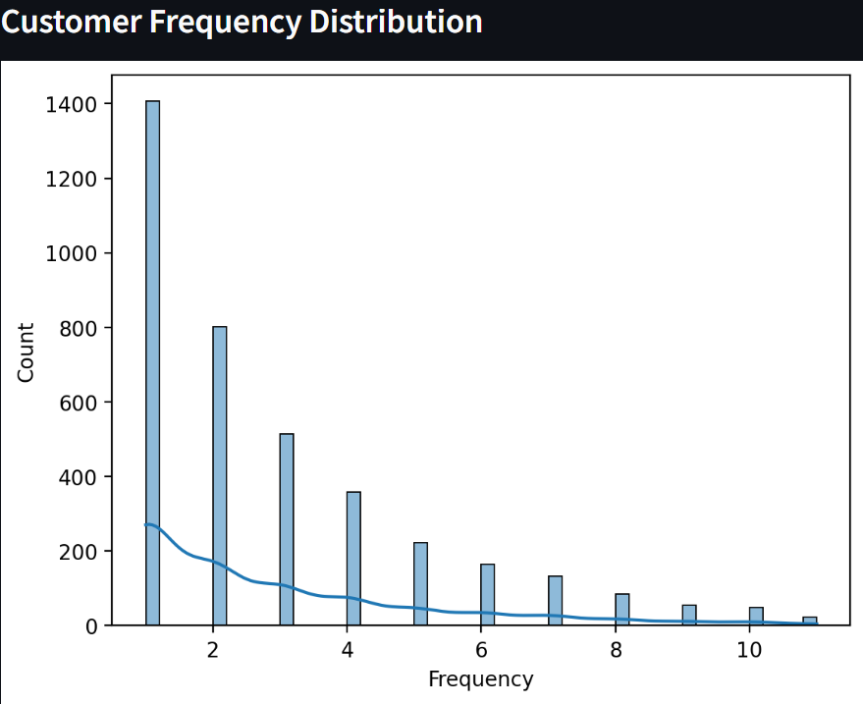

Slide 13
K-MEANS CLUSTERING
CUSTOMER SEGMENTATION

Slide 14
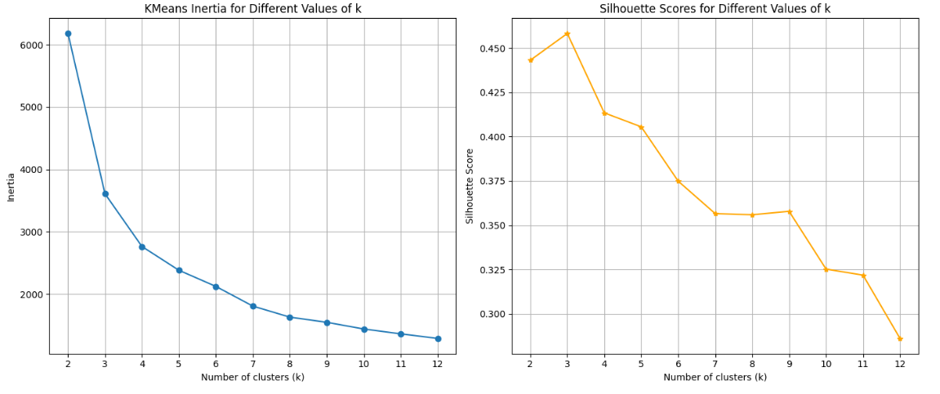
K-MEANS CLUSTRING
Used K-Means Clustering to group customers based on their MFR values.
Tested multiple cluster numbers, ranging from 2 to 10 clusters.
Implemented StandardScaler to ensure that each feature is normalized.

Slide 15
CLUSTERS
VISUALIZATION

Slide 16
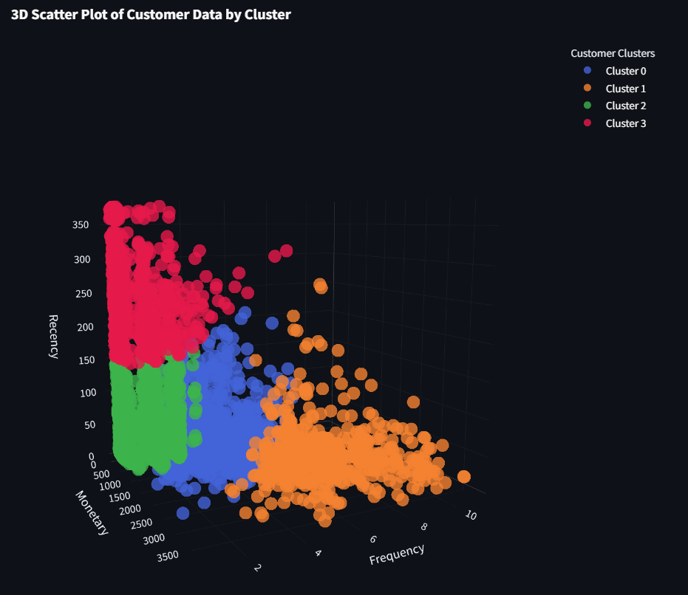
Visualization

Slide 17
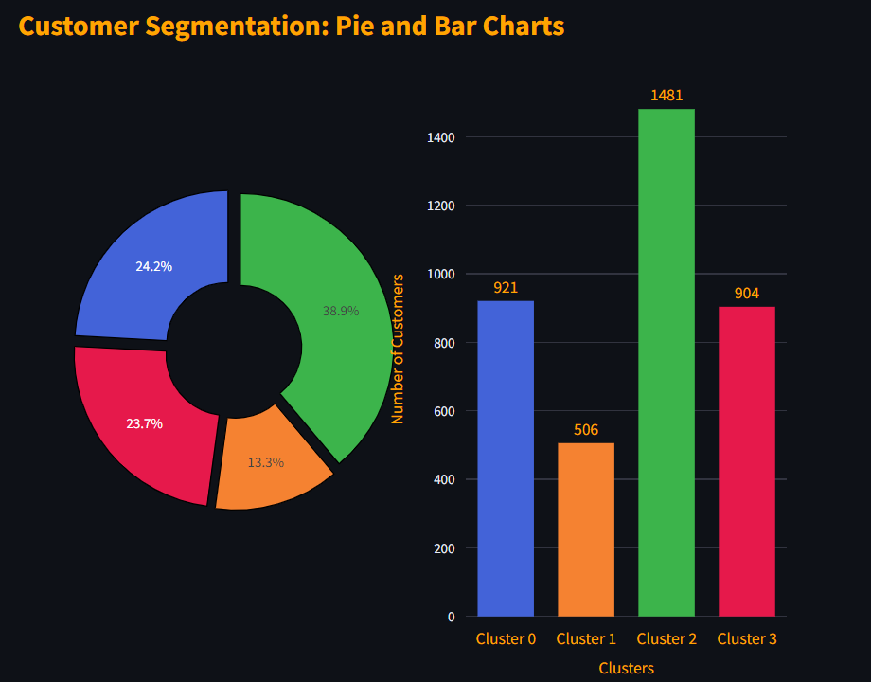
Visualization

Slide 18
SEGMENTATION
INSIGHTS

Slide 19
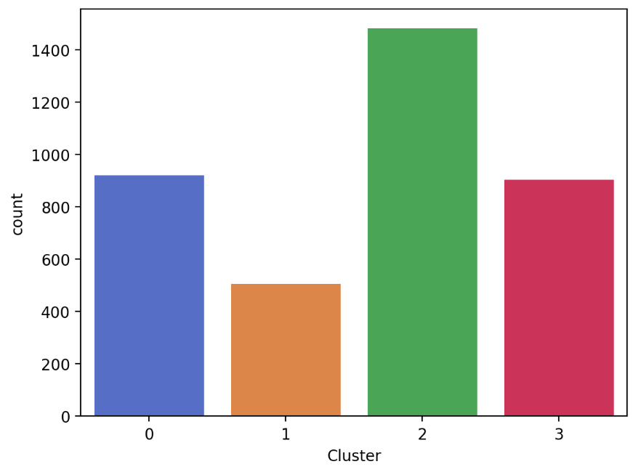
INSGHTS
Cluster 0 (Blue): "Moderate-Value, Infrequent, Active Recency"
Monetary Value:
Average value: 1,298.68
Range: 97.4 to 3,138.04
Represents customers with moderate spending patterns.
Frequency:
Average frequency: 3.89
Most customers have between 3 to 5 engagements.
Recency:
Average recency: 51.50
These customers have interacted relatively recently.
Suggested Actions:
Upsell and Cross-Sell: Leverage mid-level promotions or recommend complementary products to increase their spending.
Maintain Engagement: Send reminders or product recommendations to keep them engaged and increase the frequency of purchases.

Slide 20
INSGHTS
Cluster 1 (Orange): "High-Value, High Frequency, Recent"
Monetary Value:
Average value: 2,443.90
Range: 628.32 to 3,817.18
This is the highest spending cluster, consisting of high-value customers.
Frequency:
Average frequency: 7.19
Customers in this group have the highest interaction rates.
Recency:
Average recency: 36.52
These customers have engaged very recently, indicating strong activity
Suggested Actions:
Loyalty Programs: Introduce exclusive deals and loyalty rewards to retain this valuable segment.
Personalized Marketing: Focus on personalized campaigns and exclusive offers to enhance customer experience.

Slide 21
INSGHTS
Cluster 2 (Green): "Low-Value, Low Frequency, Active Recency"
Monetary Value:
Average value: 416.34
Range: 3.75 to 1,399.36
Lowest monetary value among the clusters.
Frequency:
Average frequency: 1.63
Customers engage infrequently, with only 1 to 2 purchases on average.
Recency:
Average recency: 56.01
These customers have been active in recent times, presenting potential for re-engagement.
Suggested Actions:
Educational Campaigns: Use awareness campaigns to inform them about products and promotions.
Incentivize Engagement: Implement bundle offers or small discounts to increase purchase frequency and boost their average spending.

Slide 22
Visualization
Cluster 3 (Red): "Low-Value, Infrequent, Very Inactive Recency"
Monetary Value:
Average value: 391.68
Range: 1.55 to 3,537.82
Spending patterns are very low, similar to Cluster 2.
Frequency:
Average frequency: 1.43
Customers engage infrequently, with very low interaction rates.
Recency:
Average recency: 253.57
Highest recency value across all clusters, indicating these customers have not been active for a significant amount of time.
Suggested Actions:
Reactivation Campaigns: Utilize re-engagement discounts or personalized emails to understand why these customers became inactive.
Surveys & Feedback: Conduct surveys to gather insights on their disengagement and identify areas for improvement.

Slide 23
CONCLUSION

Slide 24
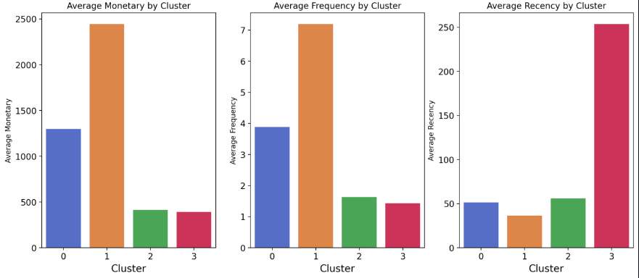
KEY TAKEAWAYS

Slide 25
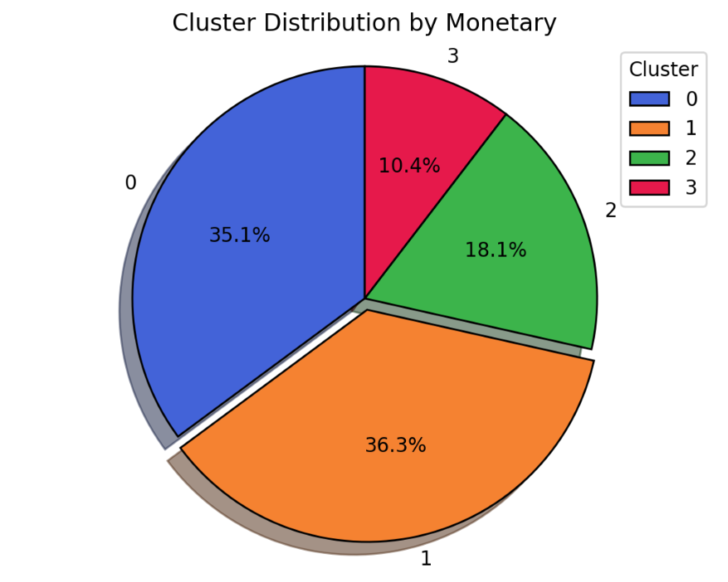
KEY TAKEAWAYS
Cluster 0 (Blue) represents a stable customer group that could be targeted for upselling or increasing frequency.
Cluster 1 (Orange) is the primary segment to focus retention strategies on, as they have high value and recent engagement.
Clusters 2 and 3 (Green and Red) require efforts to increase engagement and spending, especially Cluster 3, which needs reactivation strategies.
----------------------------------------------------------------------------------
Clusters 0 and 1 are responsable for about 71% of the revune

Slide 26



Digital Egyptian Pioneers
The End
for inquiries
+20 010 643 59672
mahmoud.raouf21@gmail.com

